Slide 1

The Travelling Salesman Problem
Presented by:
Elizer Ponio Jr.
Department of Computer Science
College of Computing and Information Technologies

Slide 2
Outline
Introduction and Definition
Factorial Time Complexity (n!)
Permutations
Sample Problem

Slide 3
Introduction
The travelling salesman problem, also known as the travelling salesperson problem (TSP), asks the following question:
"Given a list of cities and the distances between each pair of cities, what is the shortest possible route that visits each city exactly once and returns to the origin city?"

Slide 4


Factorial Time Complexity
$$n!$$
Where n is the number of inputs
$$3!=3•2•1=6 computations$$
$$4!=4•3•2•1=24 computations$$
$$5!=5•4•3•2•1=120 computations$$
Notes:
There is a limitation in n factorial algorithms where there is not enough compute power to find the answer

Slide 5
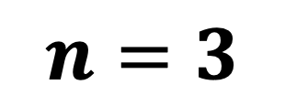


Example of n! (Permutations)
$$letters=\{A, B,C\}$$
$$n=len\left(letters\right)$$
$$n=3$$
Problem: Find all possible arrangements of the letters without omitting or repeating any letter

Slide 6
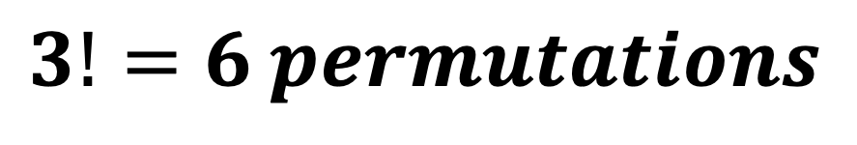
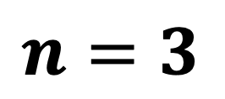
Permutations
$$n=3$$
A | B | C
A | C | B
B | A | C
B | C | A
C | A | B
C | B | A
$$3!=6 permutations$$
$$if we add one more letter, there would be 4!=24 permutations$$

Slide 7
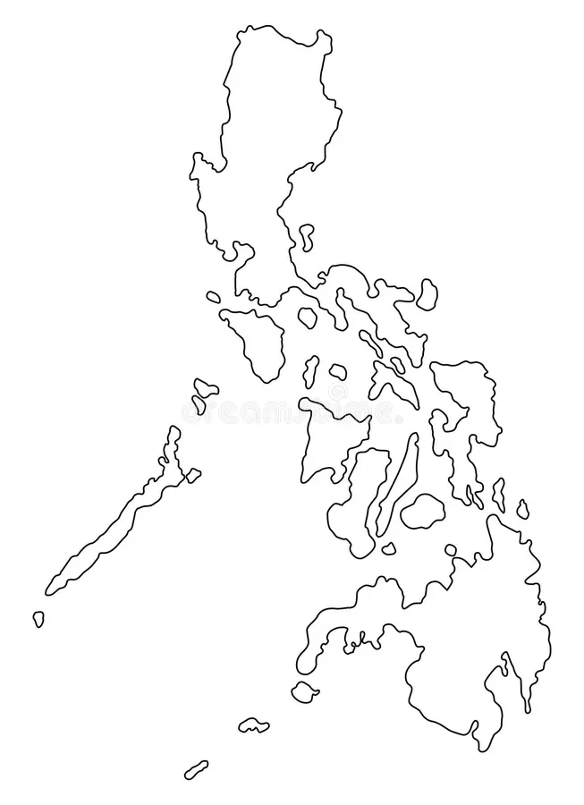
Manila
6
10
2
Tacloban
3
Puerto Princesa
7
2
Davao

Slide 8
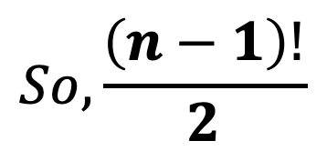
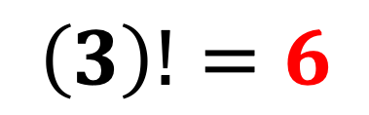

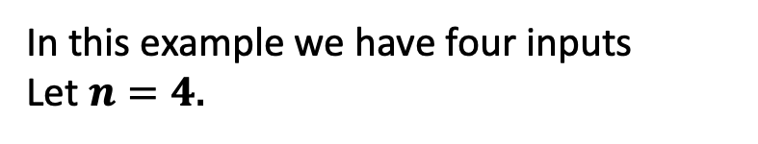
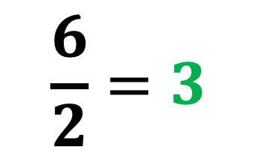
In this example we have four inputs
Let $n=4$.
Then, $(4−1)!$
Manila
$$\left(3\right)!=6$$
6
10
2
Actually, there are only 3 possible paths, the 3 other paths are only the reverse of the three possible paths!
Tacloban
3
Puerto Princesa
$$So, \frac{\left(n−1\right)!}{2}$$
7
2
$$\frac{6}{2}=3$$
Davao

Slide 9

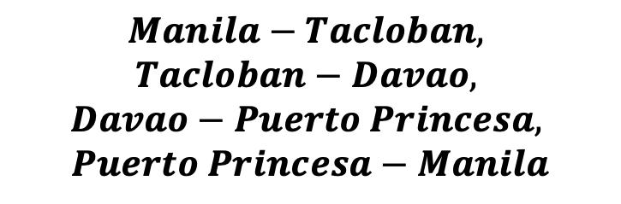
Manila
$$Manila−Tacloban,$$
$$Tacloban−Davao,$$
$$Davao−Puerto Princesa,$$
$$Puerto Princesa−Manila$$
6
10
Tacloban
Puerto Princesa
$$6+7+2+10=25$$
7
2
Davao

Slide 10

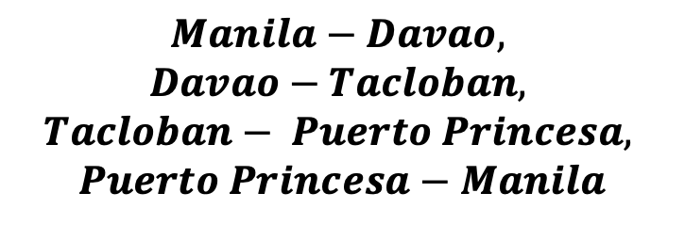
Manila
$$Manila−Davao,$$
$$Davao−Tacloban,$$
$$Tacloban− Puerto Princesa,$$
$$Puerto Princesa−Manila$$
10
2
Tacloban
3
Puerto Princesa
$$2+7+3+10=22$$
7
Davao

Slide 11

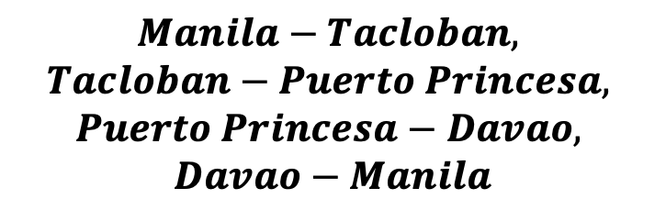
Manila
$$Manila−Tacloban,$$
$$Tacloban−Puerto Princesa,$$
$$Puerto Princesa−Davao,$$
$$Davao−Manila$$
6
2
Tacloban
3
Puerto Princesa
$$6+3+2+2=13$$
2
Davao

